Slide 1

E-COMMERCE WEBSITE-
Mentor: Prof: R. Rama Kishore
SUBMITTED BY : Mayank Singh
ROLL NO. : 04216403217
COURSE : BTECH (CSE)

Slide 2
ROLES
MAYANK SINGH
SUMIT KUMAR
FRONT END DEVELOPER
Developed the User Interface of the project, which are features that are directly viewable and accessible to the end user or client.
BACKEND DEVELOPER
Developed the server side code and database, connected the frontend, server and database altogether.

Slide 3
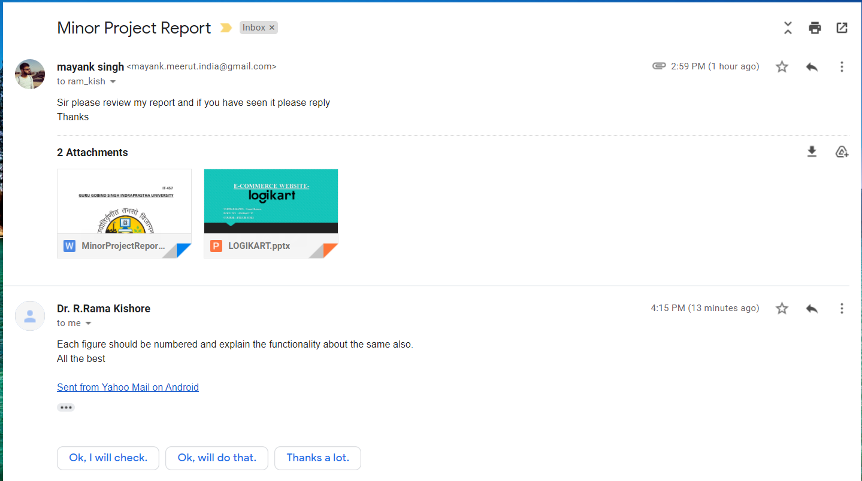
Teachers remark

Slide 4
PROBLEM STATEMENT (ABSTRACT)
Our project is Logi-Kart. This is a website which helps people to find and buy all type of Video Gaming Peripherals on internet. It is useful in the way that it makes an easier way to buy video gaming products online. Logi-Kart is an interactive e-commerce solution providing users with an opportunity to buy their favorite pc parts. Logi-Kart is the first online platform which deals with new pc accessories of all fields.
For getting access to the site, the customer has to be a registered user, if it is a new user then he has to register himself. After logging in to the website the user can choose from the categorical listing of products from the products page. Our website also provides cart system and checkout page along with all kind of payment support. The user can track the ordered product at any point of time.

Slide 5
TECHNOLOGIES STACK
FRONTEND
BACKEND
CASCADING STYLE SHEETS (CSS)
BOOTSTRAP
JAVASCRIPT
HTML
Database : SQLite
Framework : DJANGO
PYTHON

Slide 6
BRIEF OF TECHNOLOGIES USED
CASCADING STYLE SHEET : Cascading Style Sheets is a style sheet language used for describing the presentation of a document written in a markup language such as HTML.
JAVASCRIPT : JavaScript is high-level, often just-in-time compiled, and multi-paradigm programming language.
BOOTSTRAP : Bootstrap is a free and open-source CSS framework directed at responsive, mobile-first front-end web development.
HTML: Hypertext Markup Language (HTML) is the standard markup language for documents designed to be displayed in a web browser. It can be assisted by technologies such as Cascading Style Sheets (CSS) and scripting languages such as JavaScript.

Slide 7
…CONTINUED
PYTHON: Python is an interpreted, high-level and general-purpose programming language. Python's design philosophy emphasizes code readability with its notable use of significant whitespace.
DJANGO: Django is a high-level Python Web framework that encourages rapid development and clean, pragmatic design.
SQLite: SQLite is a C-language library that implements a small, fast, self-contained, high-reliability, full-featured, SQL database engine.

Slide 8
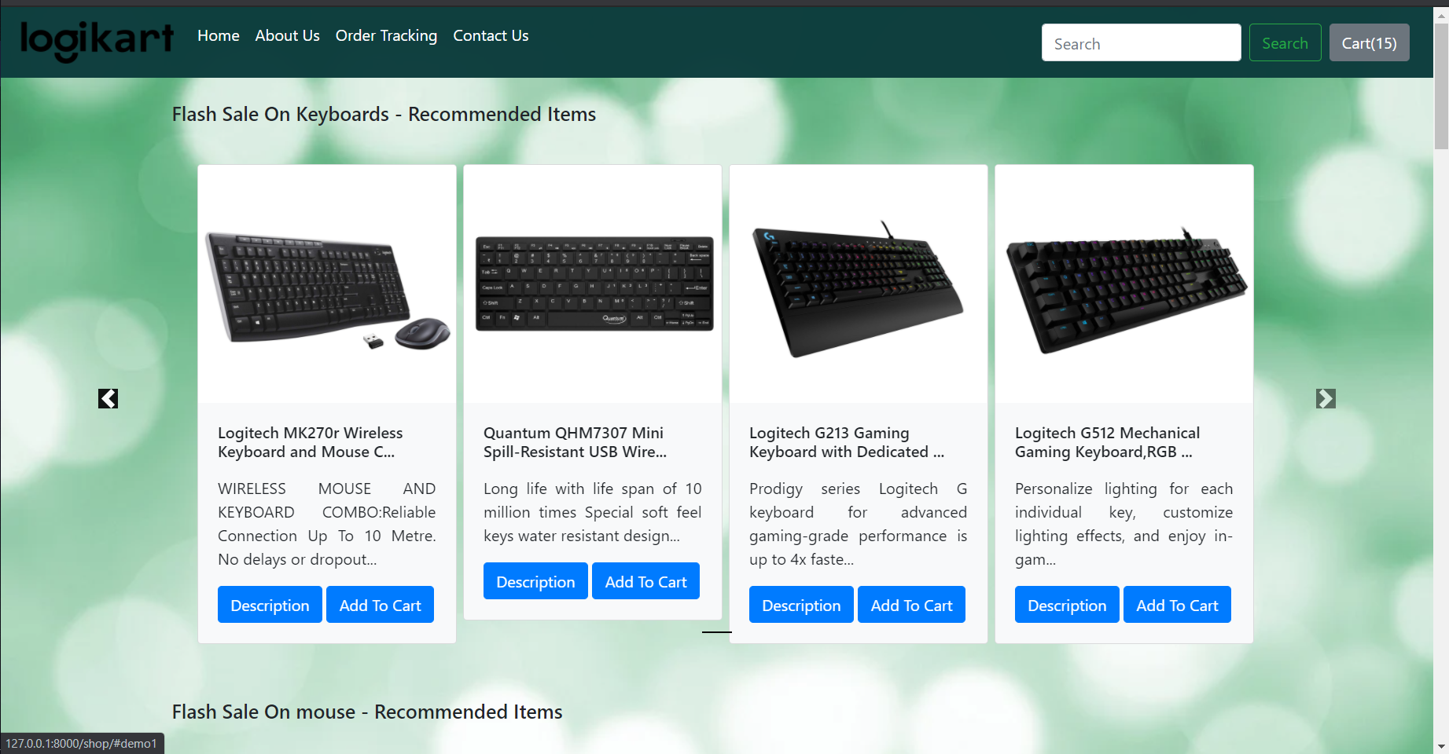
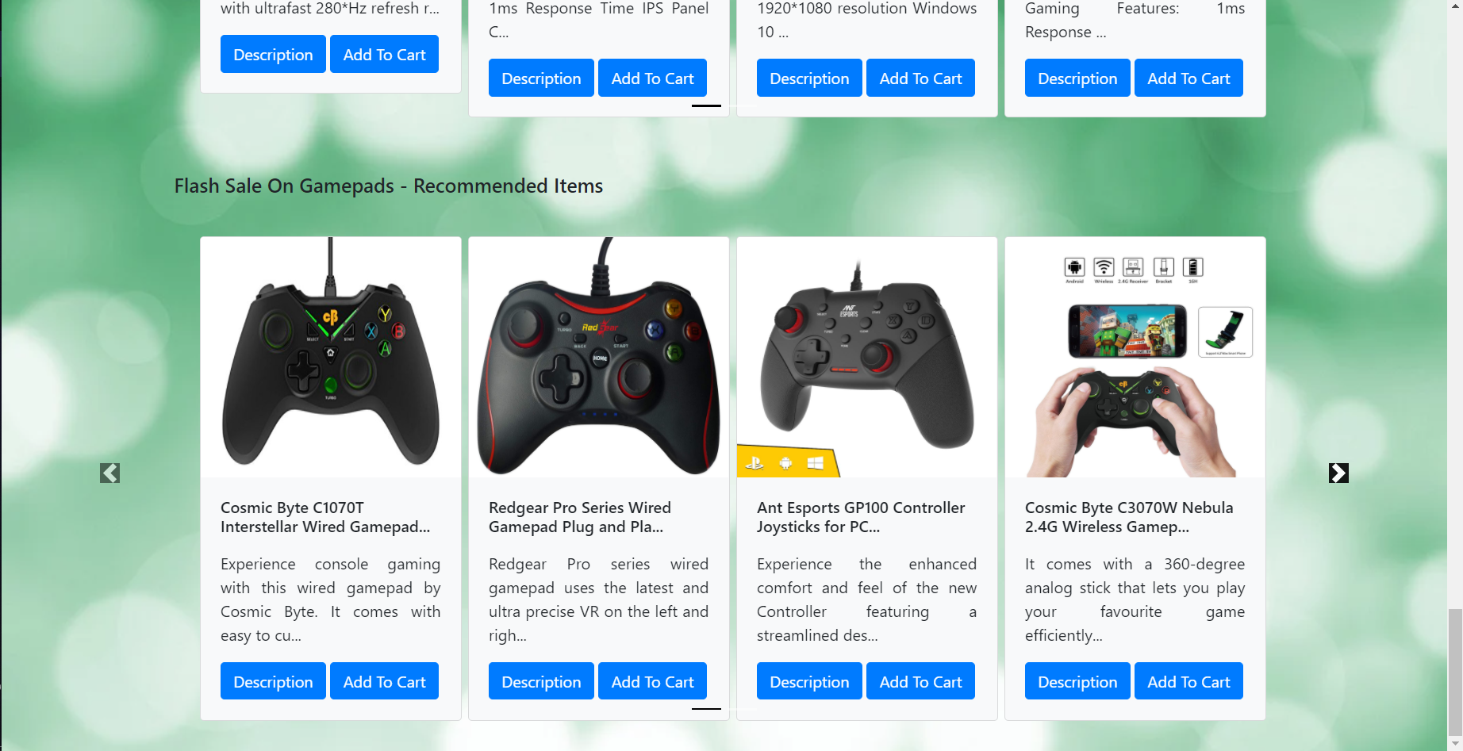
SIMULATION

Slide 9
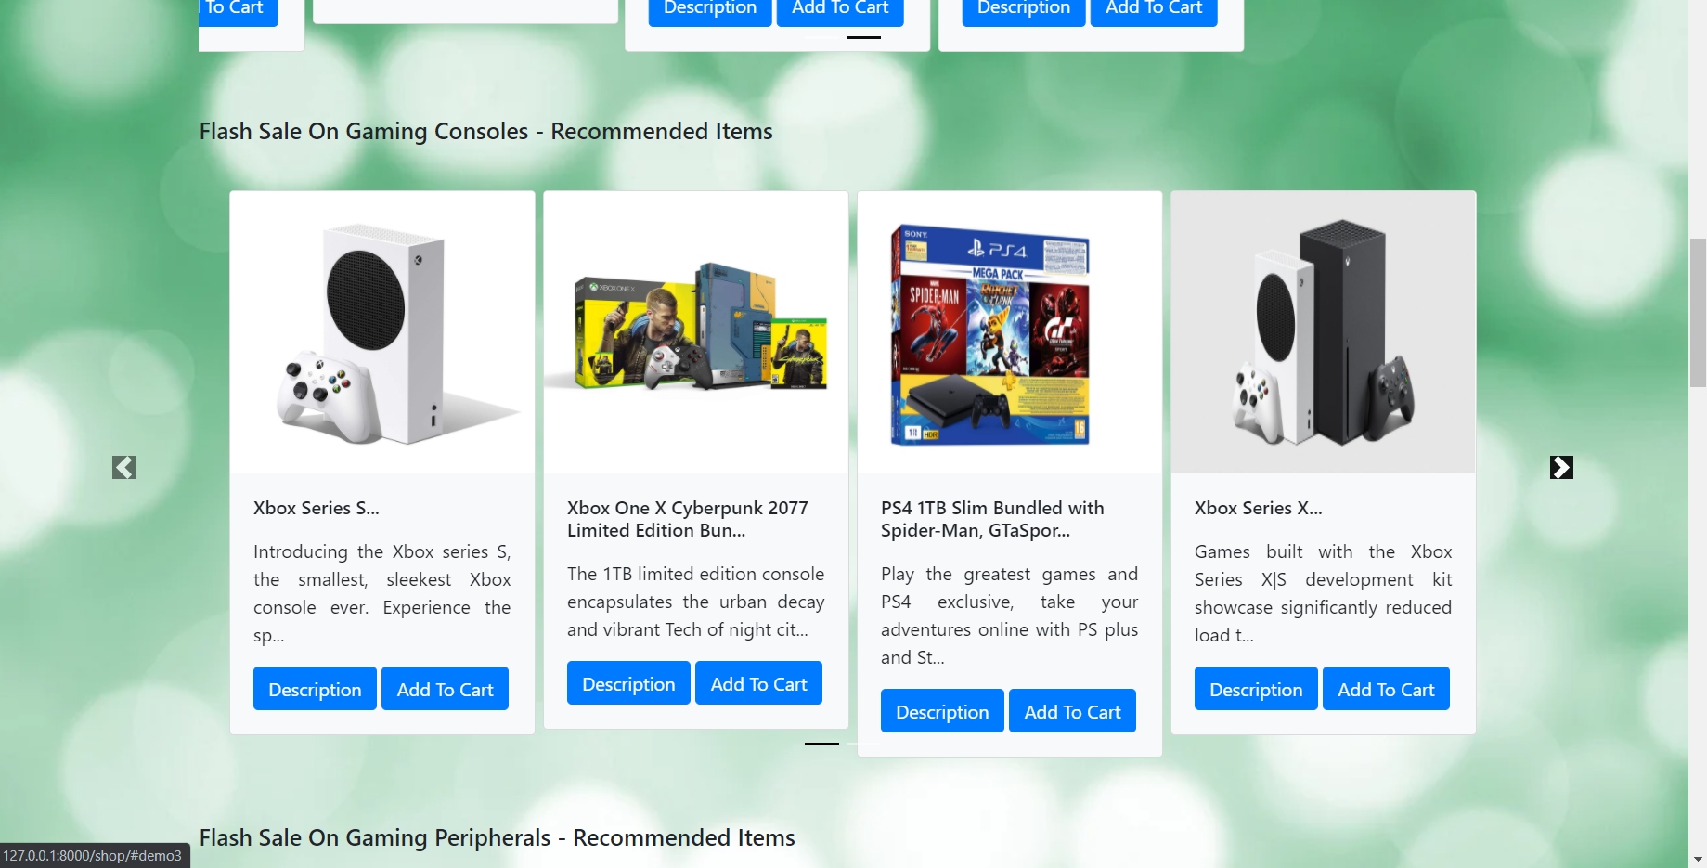
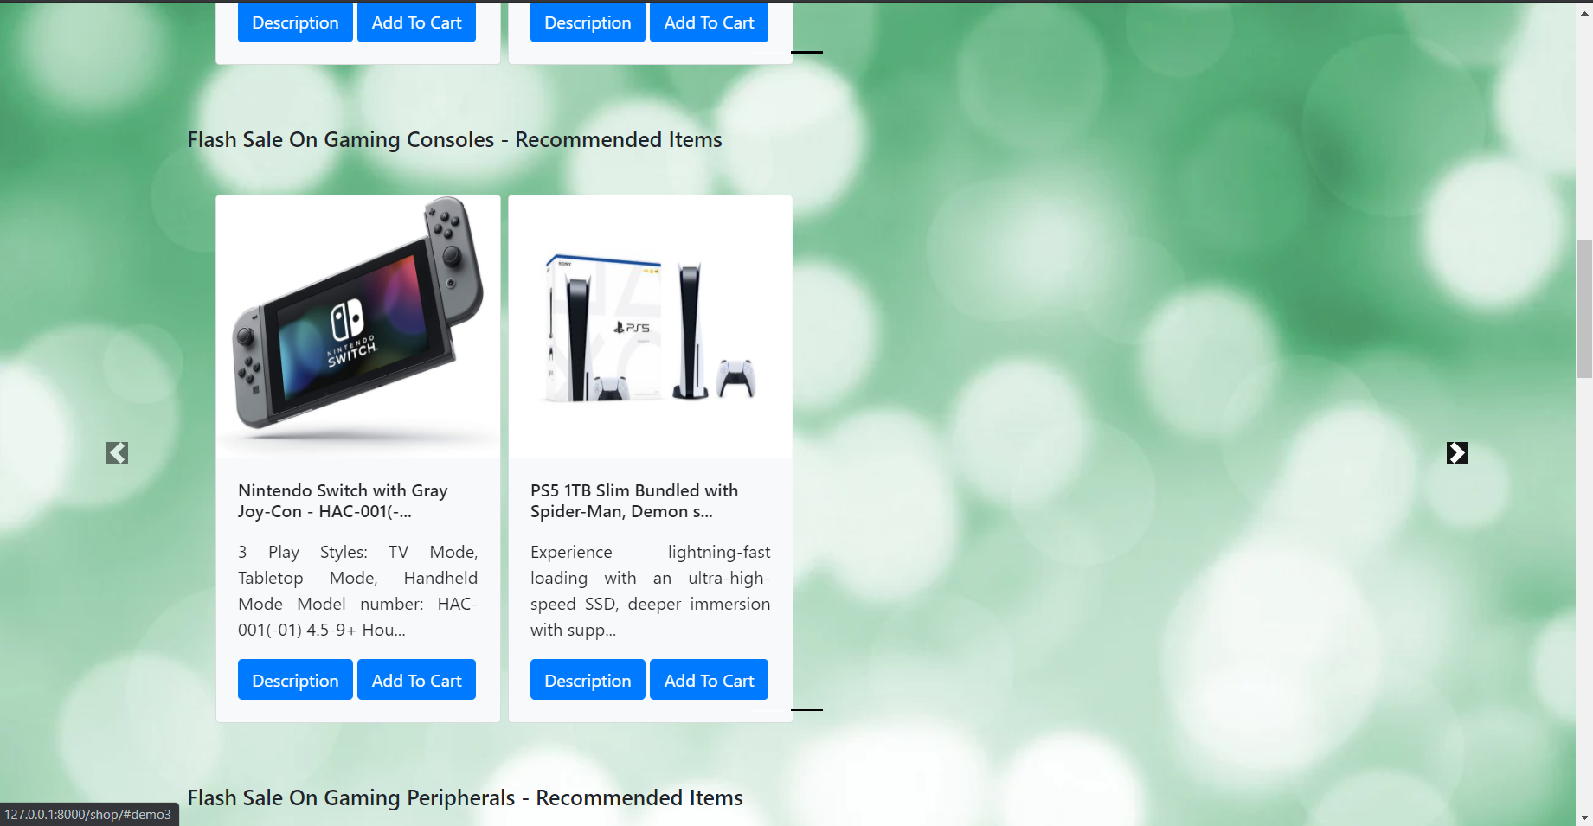
Home Page:

Slide 10
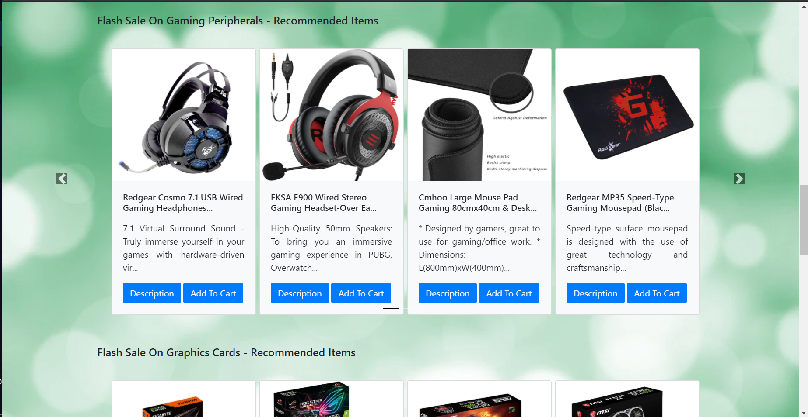
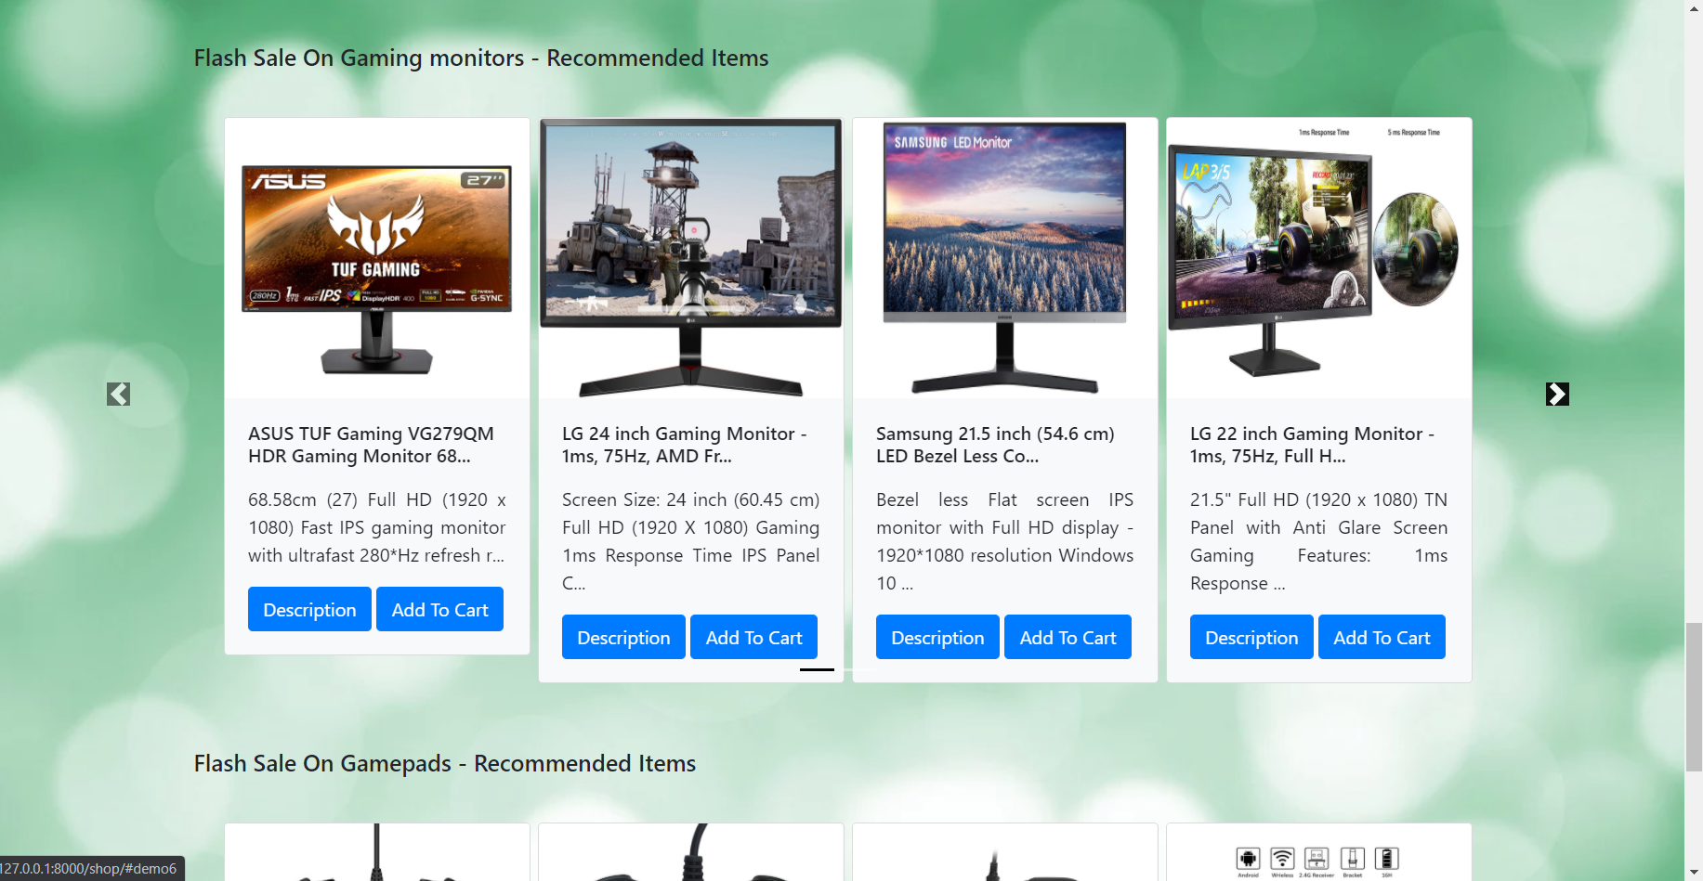
Home Page Cont.:

Slide 11
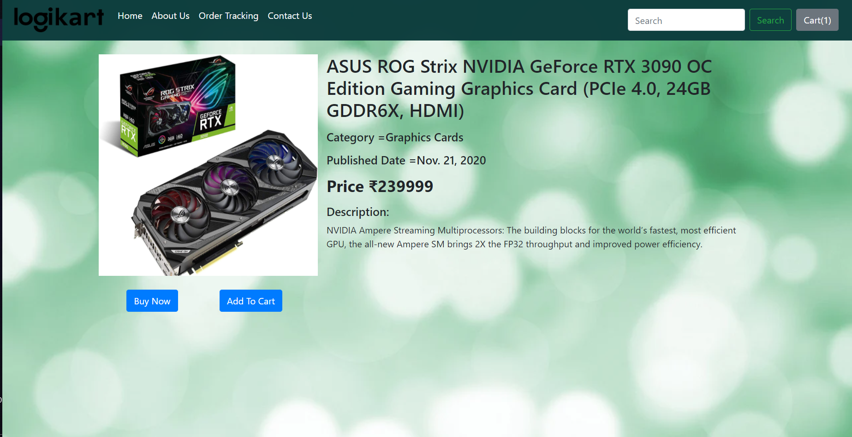
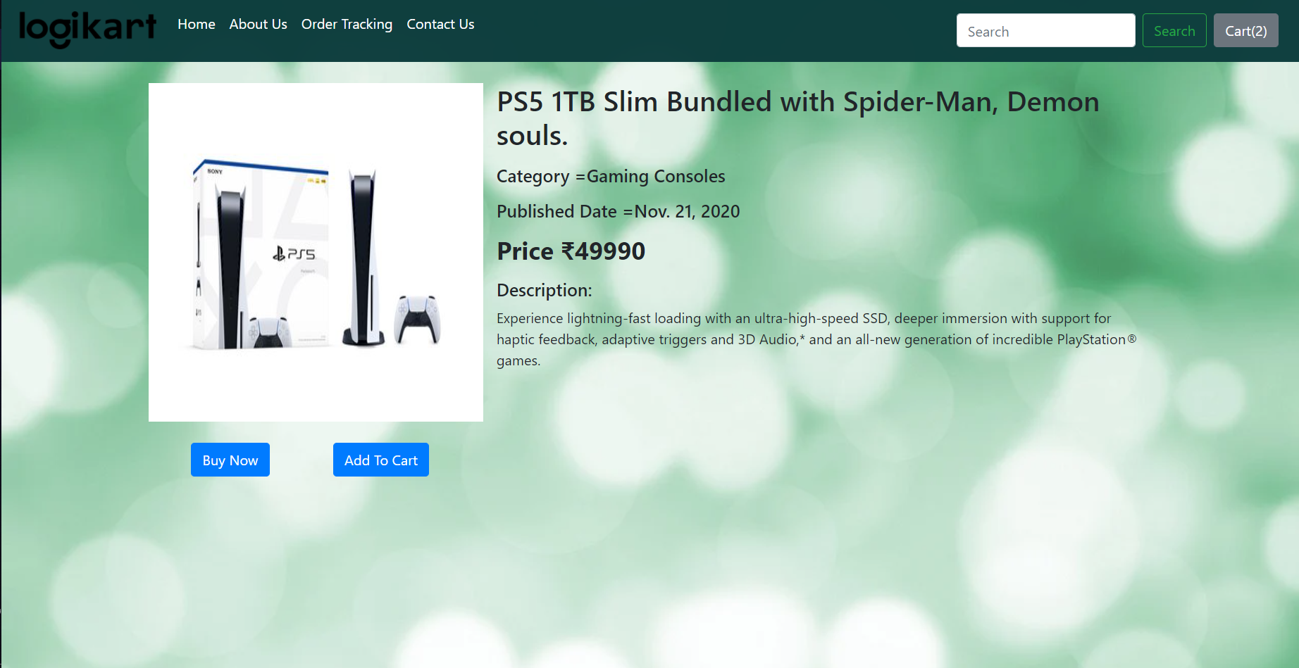
Product Page:

Slide 12
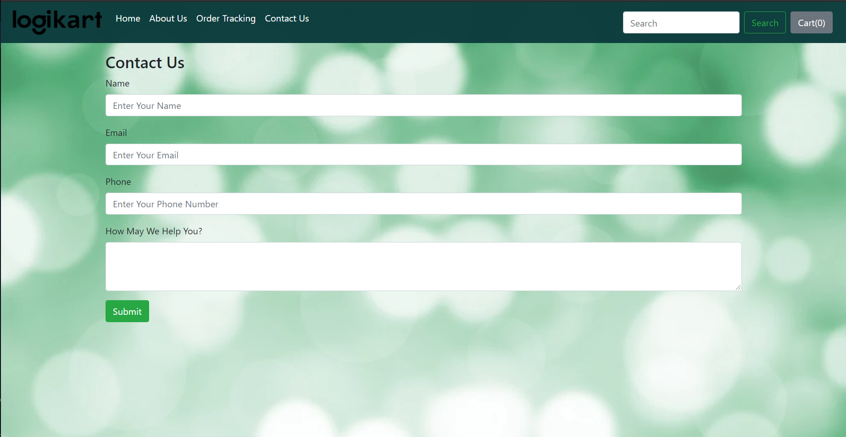
Contact Us Page

Slide 13
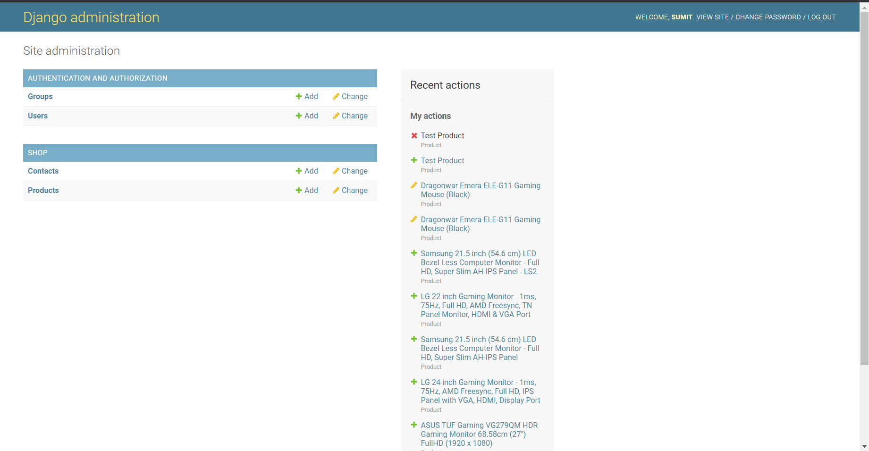
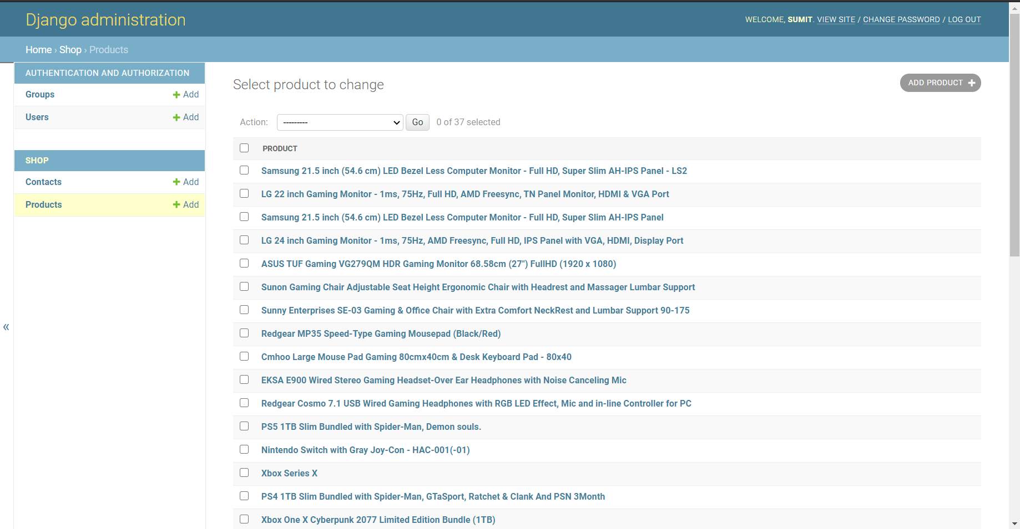
Admin Interface:

Slide 14
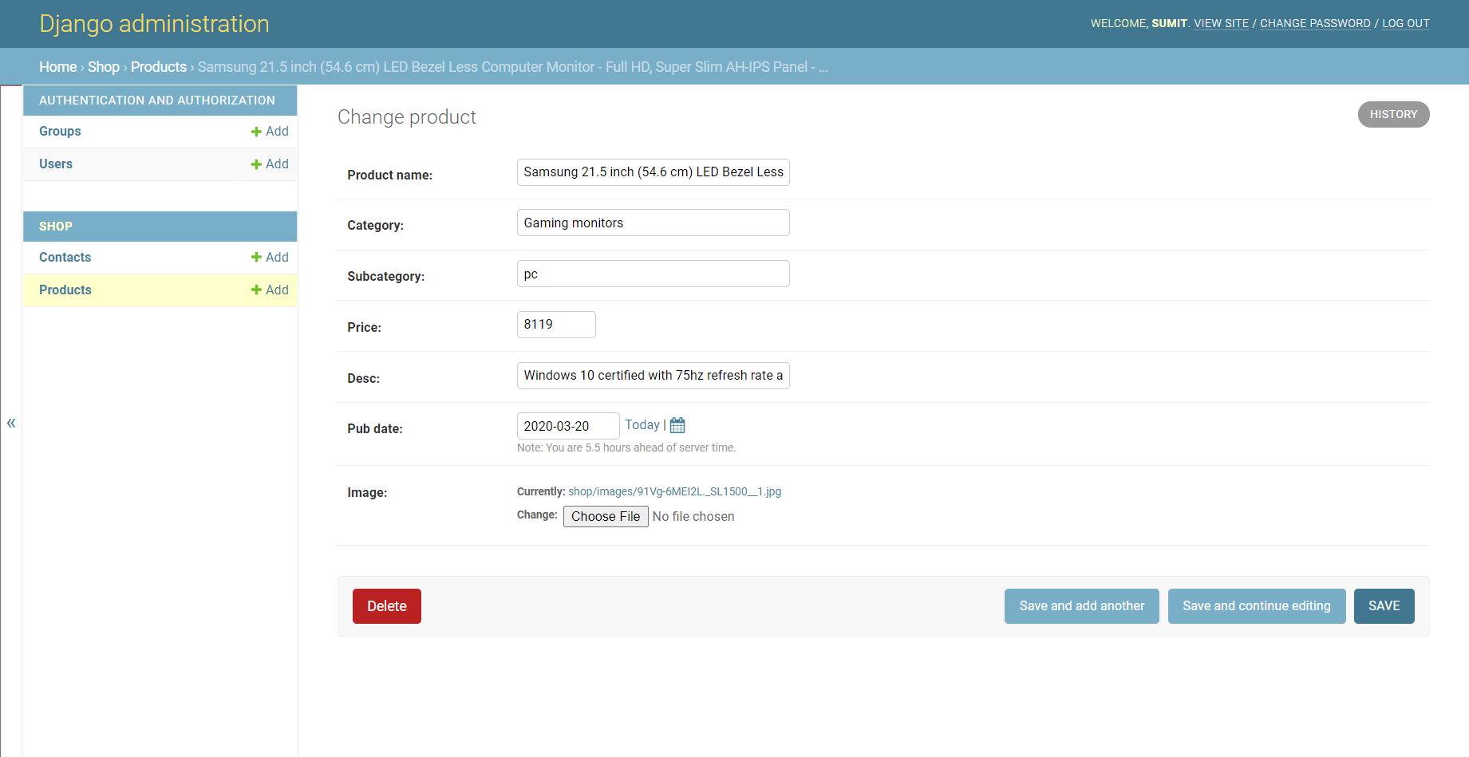
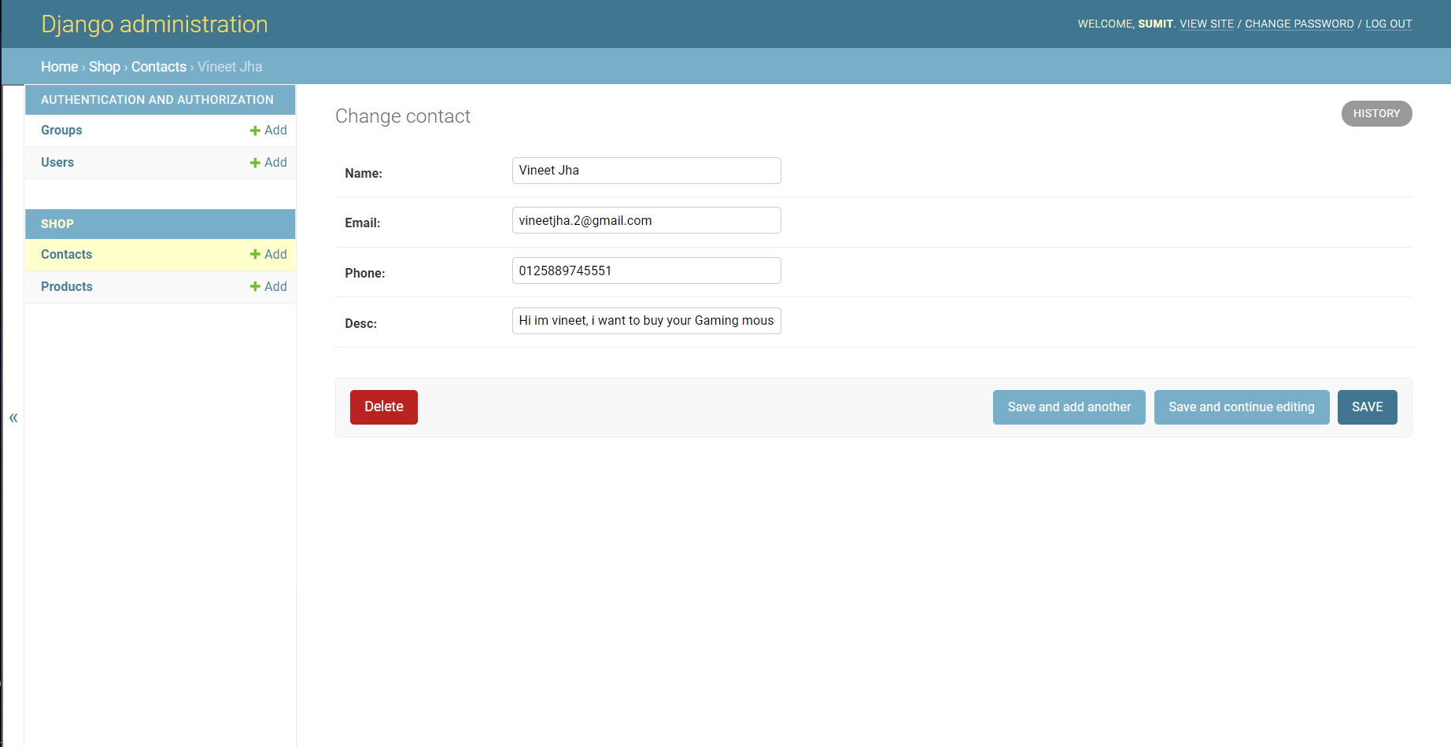
Admin Interface Cont. :

Slide 15
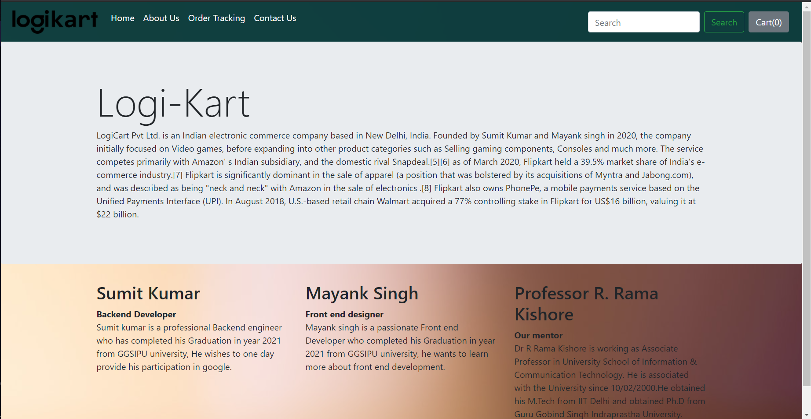
About Us Page:

Slide 16
THANK YOU

